Slide 1
STATegra: Multi-Omics Data Integration – A Conceptual Scheme With a Bioinformatics Pipeline
Group 1

Slide 2
What is STATegra about?
A collection of tools and guidelines for step-wise integration of different kinds of OMICS data.
Performs integration using two approaches
Component Analysis: Identifying what are important features in multiomic datasets that explain most of the variability across modalities. (DISCO-SCA,JIVE & O2PLS). The objective is to check how much the different data-types (e.g., different omics) and their features were “coordinated.”
Non-Parametric Combination (NPC) analysis to leverage on paired designs to increase statistical power

Slide 3
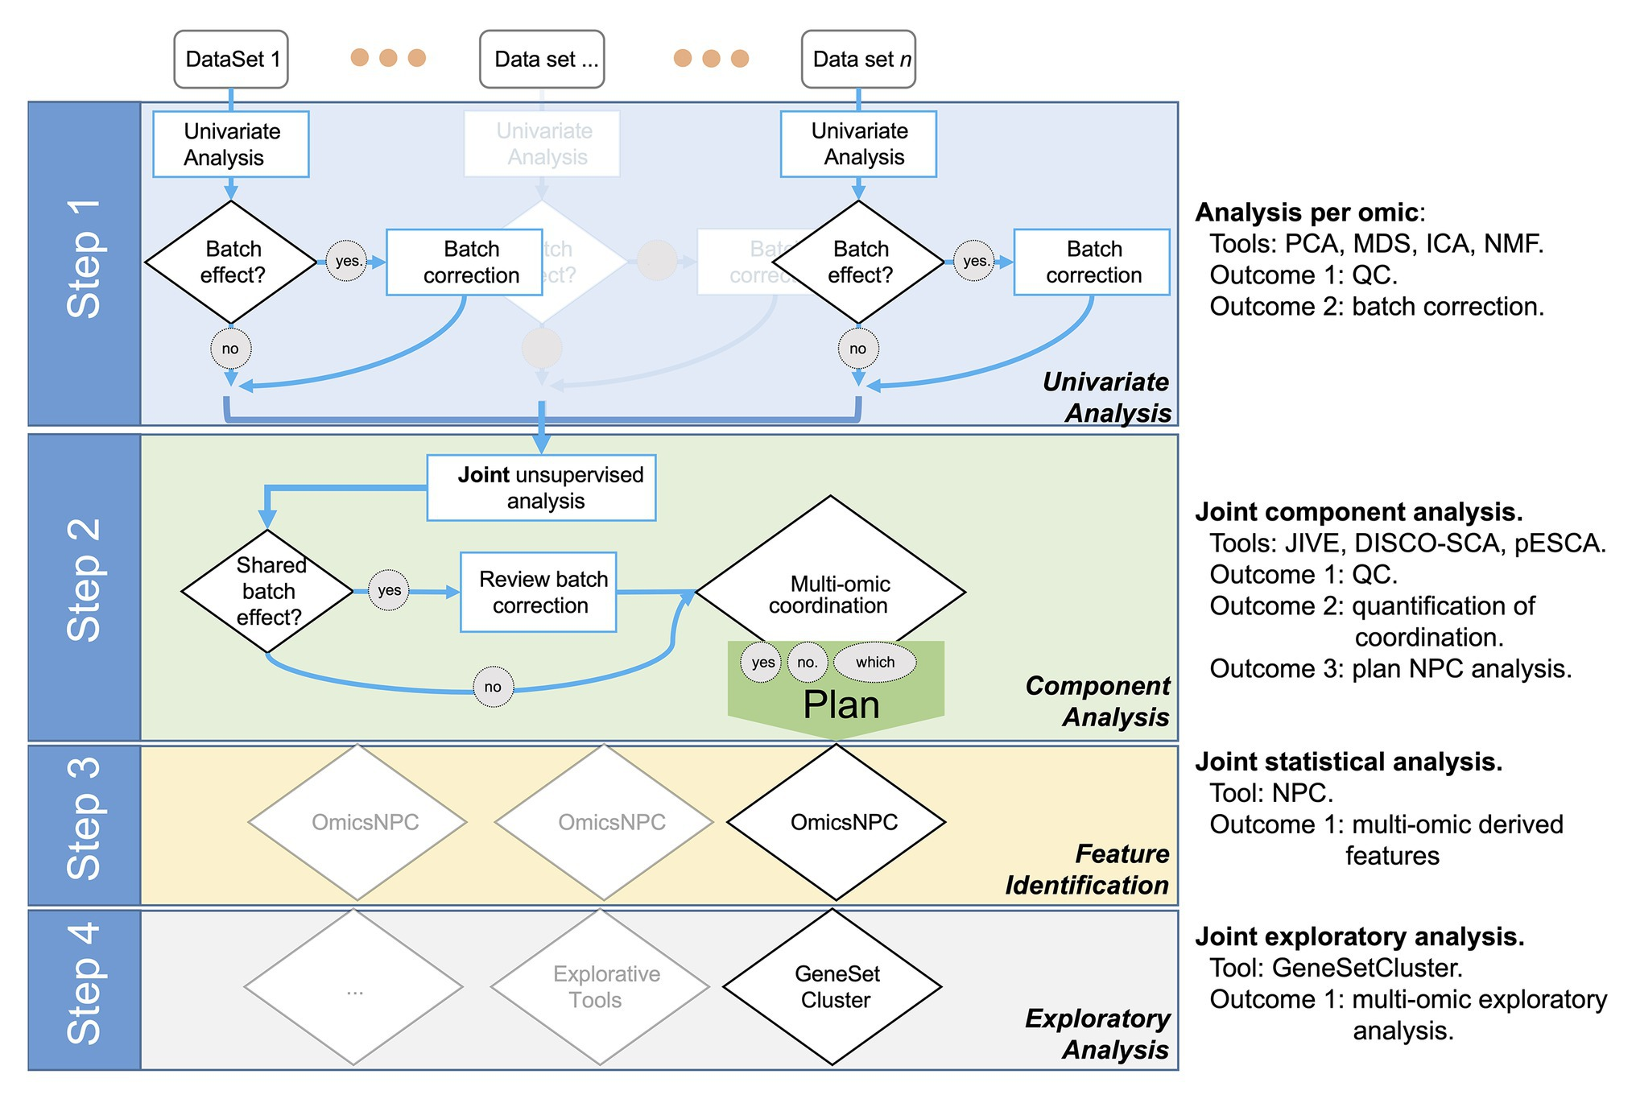
Overview of Integration Guideline

Slide 4
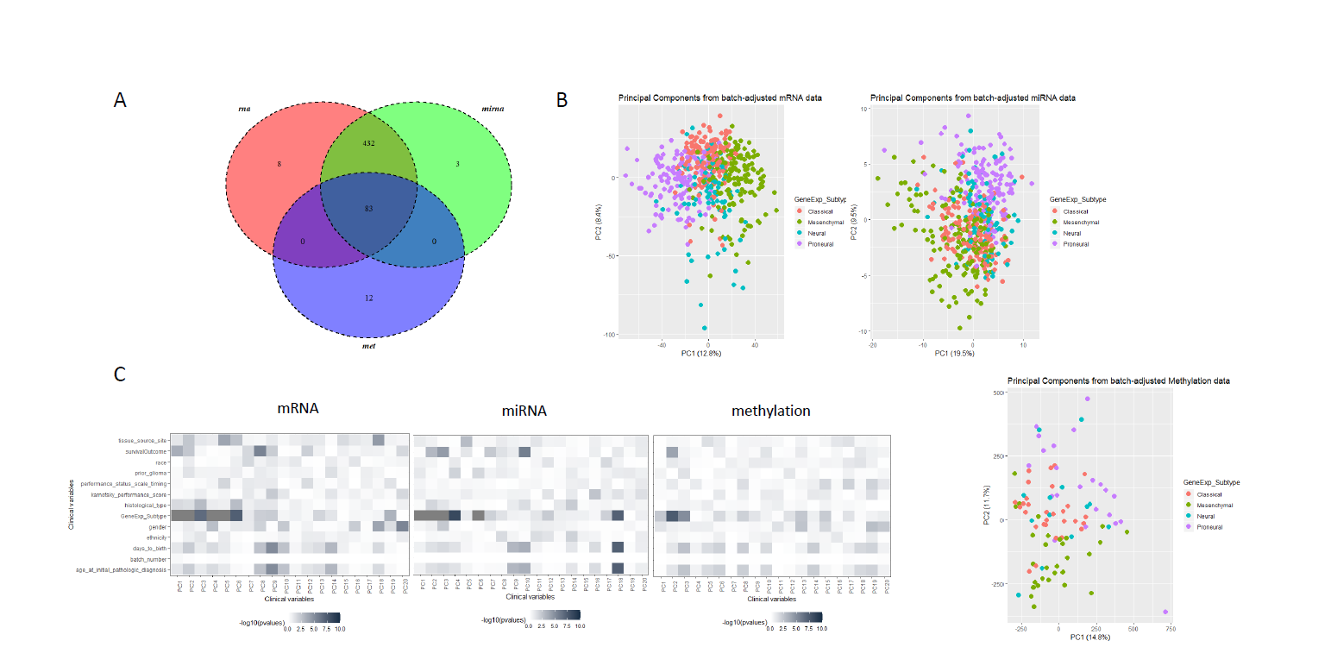
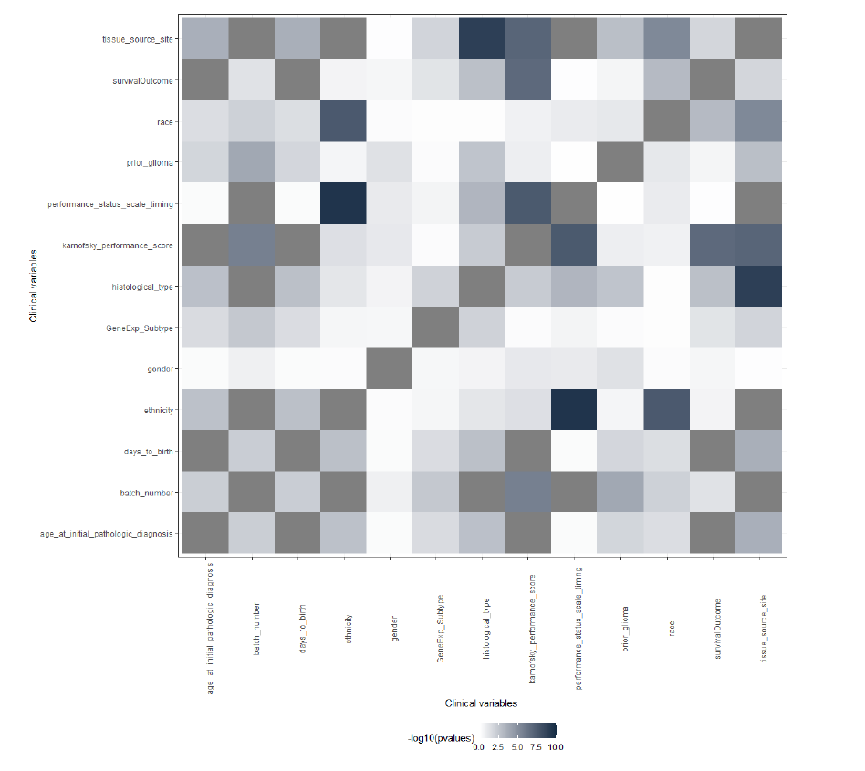
Step1. Assessing Data quality of modalities individually

Slide 5
Component Analysis
Step1. Data preparation:
i) each feature must be scaled and
ii) choose whether to analyze samples that are common to the two data types or all the samples
Step2. Model selection for component analysis i.e. which one out of these methods is better: JIVE, PCA-GCA, and pESCA.
Step3. Select feature(s) that explain most variability across different data types. These features are known information about samples like, age/sex/cell-subtypes etc.

Slide 6
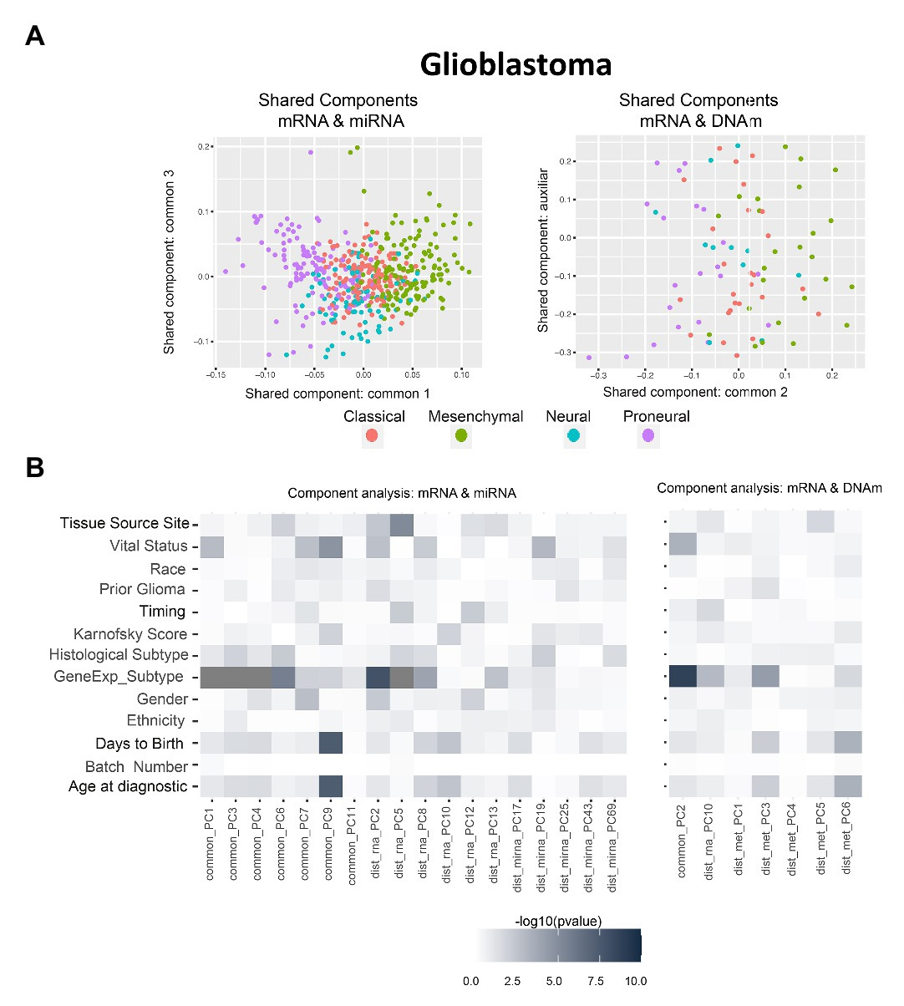
Step 2. Joint Component Analysis
“gene expression subtype” for integrating all three: mRNA-miRNA, mRNA-DNAm)
survival outcome and age for mRNA-miRNA

Slide 7
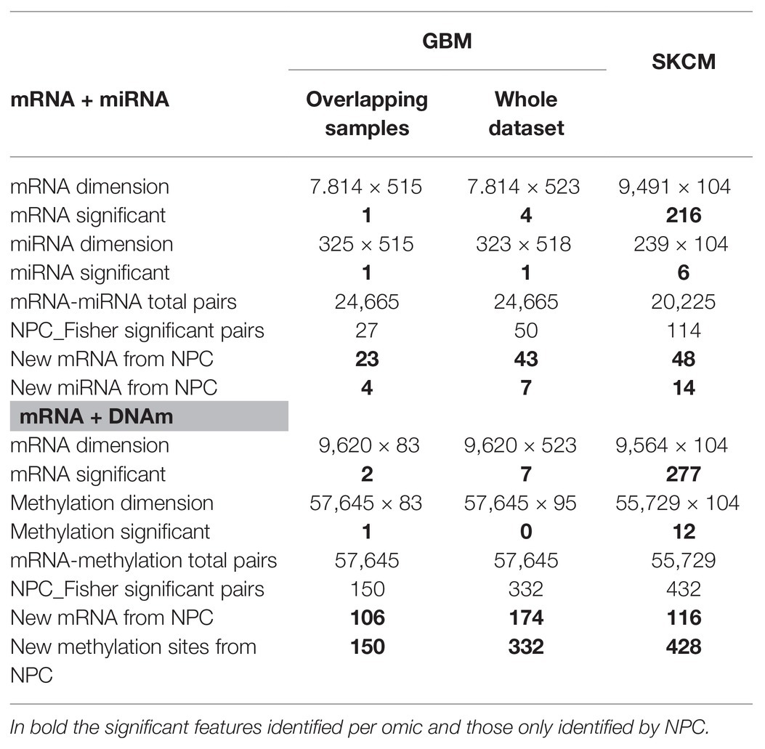
Step 3. Nonparametric combination
How can we combine p-values from different assays to draw a global conclusion?
miRNAs and RNA that are coordinated
New pairs of miRNAs and mRNAs not found when analyzed each data type separately.
Notes:
When the NPC is applied on “mRNA and miRNA,” the integration allowed identifying 23 new genes and four new miRNAs. For “mRNA and DNAm,” the integration allowed identification of 106 new genes and 150 new CpG sites.

Slide 8
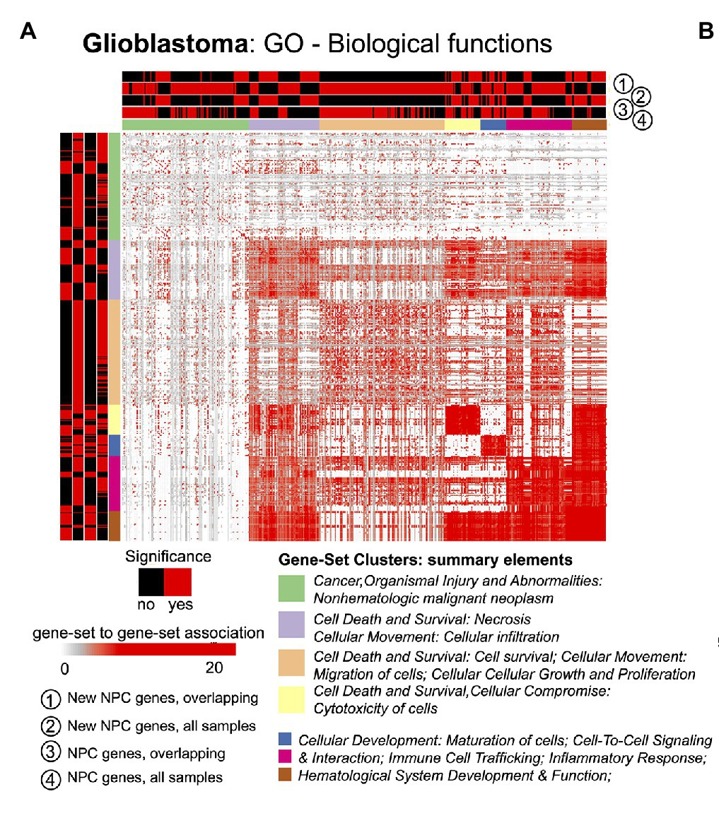
Step 4. Exploratory Analysis and Determination of the Framework’s Added Value
New features identified by integrating two assays together allow for identifying relevant pathways that were not described before.

Slide 9
Conclusions/Remarks
Component Analysis
quantifies the coordination of the different data-types
identification of relevant variables across assays
identify where omic-combination can be leveraged
Non-Parametric Combination is used to gain statistical power
Explores the added value of the biological-insights of the features identified by the integration process.

